Slide 1
Mini-I/O Field Installable Cable Connector
INSTRUCTION: Cover image below may be replaced in the slide master with another image from either the Images Library PowerPoint provided along with this template OR a licensed image which meets TE’s photography guidelines to meet user’s requirement. Delete this instruction in final presentation.
Ruud van den Brink
GPM Industrial Communications
2021-03-08

Slide 2
Agenda
Introduction to Mini-I/O
Standardization & Standards
Typical Mini-I/O Applications
Field Installable Cable Connector
How to Apply the Mini-I/O FI Cable Connector

Slide 3
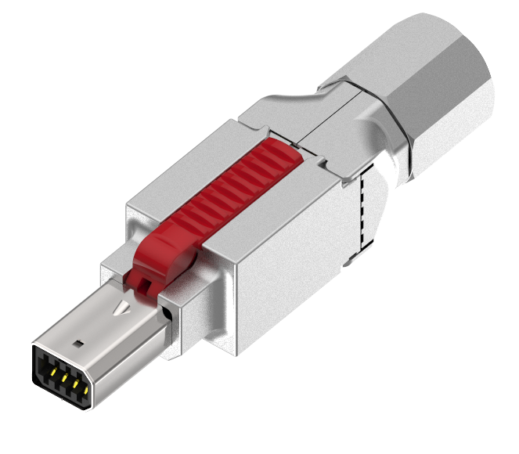
Introduction to Mini-I/O
Summary
Mini-I/O is a ruggedized, miniaturized connector family suited for Serial, Bus, Ethernet communication
Wide area of applications, incl. Cabinets, Distributed peripherals, Robotics, Machinery, Drive and Motor Applications
Technology
IEEE 802.3 standards from 10 Mbps to 10 Gbps
Connector standard series IEC 61076-3-122
Benefits
Cost-effective, toolless, error free installation
Compact connector design (25% of the size of RJ45)
Integrated power (PoE)
Dual contact point contact technology guarantees good shock and vibration properties
Next steps:
Drive adoption into the industrial market through standardization and user groups
Succesively introduce other Mini-I/O FI cable connecotrs for different wire and cable diameters
Product launches in FY20/FY21

Slide 4
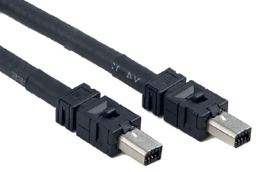
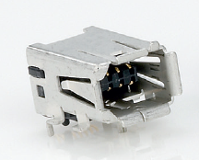
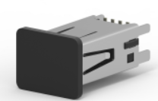
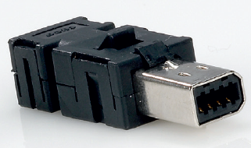
Mini-I/O Product Family
Mini-I/O Cord sets
Type 1 and Type II
R/A and vertical Board Connectors
Type 1 and Type II
Solder and piercing cable connectors
Type 1 and Type II
Link to product flyer:
Link to virtual sample kit:
https://www.te.com/commerce/DocumentDelivery/DDEController?Action=srchrtrv&DocNm=1-1773703-8_MINI_IO&DocType=DS&DocLang=EN
https://www.te.com/commerce/DocumentDelivery/DDEController?Action=showdoc&DocId=Data+Sheet%7F7-1773983-5%7F2006%7Fpdf%7FEnglish%7FENG_DS_7-1773983-5_2006.pdf

Slide 5
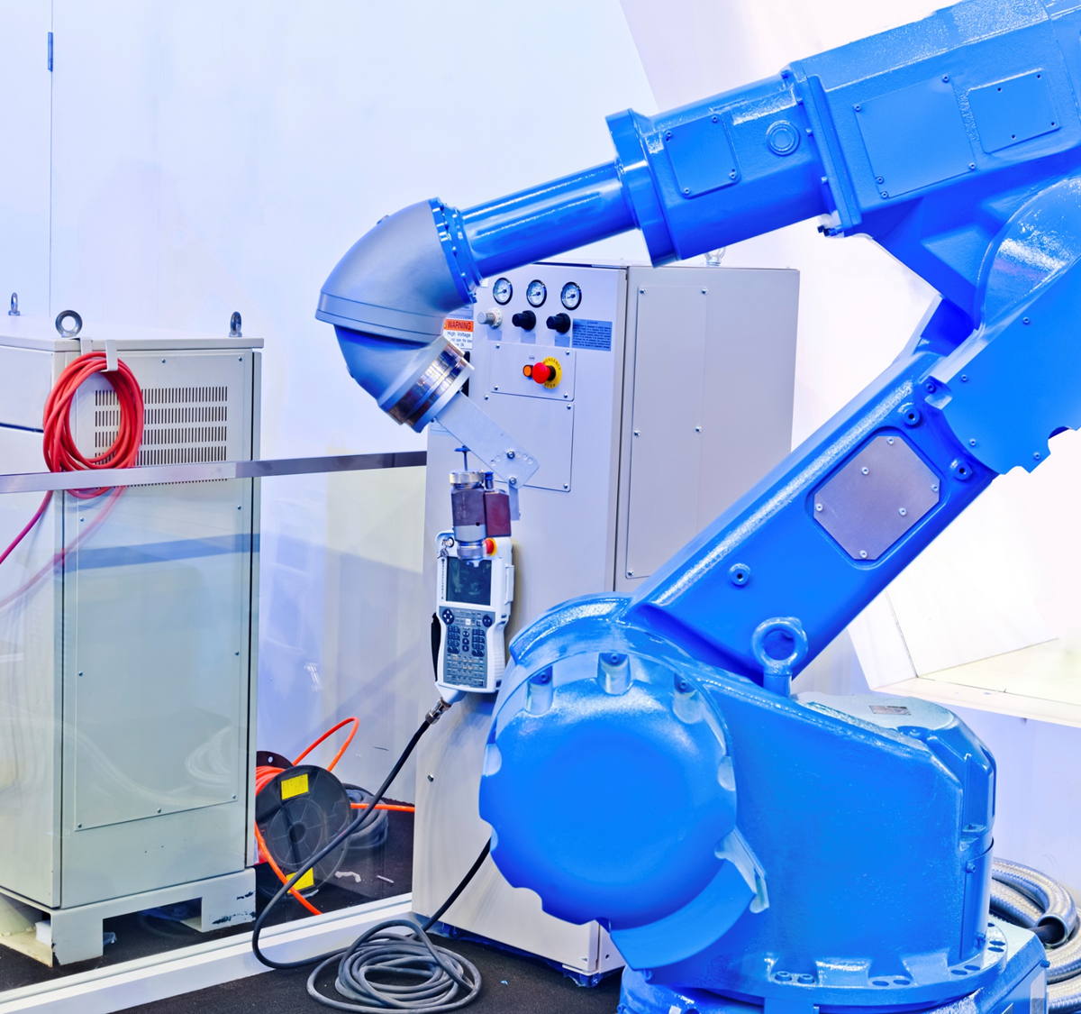
Industrial Mini-I/O Connector Advantages

Slide 6
Connector Interface Type I and Type II
Industrial Mini I/O has 2 unique interfaces which may be used by customers to prevent mis-mating
Key customer benefit is that using this interface physically prevents improper network hook up with other standard RJ45 networks
Customers may also use this interface for physical identification of critical networks (i.e. safety)
Other coding variants are possible
Type I:
D-shape
Type II:
U-shape
Can not mis-mate
D-SHAPE TYPE 1
U-SHAPE TYPE 2

Slide 7
Secure Interface Locking System
Accidental unplugging of a network connection due to shock, vibration, pulling on cords, etc.. Causes expensive down time in an industrial environment
Industrial Mini I/O’s unique locking system has a pull out force greater than 100N
Lock ejector
Plug lock projection
Header lock leaf

Slide 8
PCB Header Designed for Board Strength
The other part to secure a lasting connection is proper board retention
This header design has 2 features to enable required retention strength
  Solder pads at 5 points
  3 pegs with through hole anchor
  Plastics are LCP based, improving co-planarity, supporting reflow soldering and giving it a MSL1
②
①
① Solder pad at 5 points
② Peg has through hole anchor (3/5)
Solder pads are used to fix the SMT connector to a PCB. Generally this is done at 2 points. Industrial Mini-I/O has 5 points enhancing the retention force and preventing connector tilt.

Slide 9
Mini-I/O Contact System Designed for Reliability
Contact Cross Section
Known as the “Fighting Snake Principle”
Multiple points of contact reduce contact failures
Au plated products improve conductivity and contact lifespan
Overall design = Improved Reliability for Customer Networks
2 points of contact
Cable Side Contact
PCB Side Contact

Slide 10
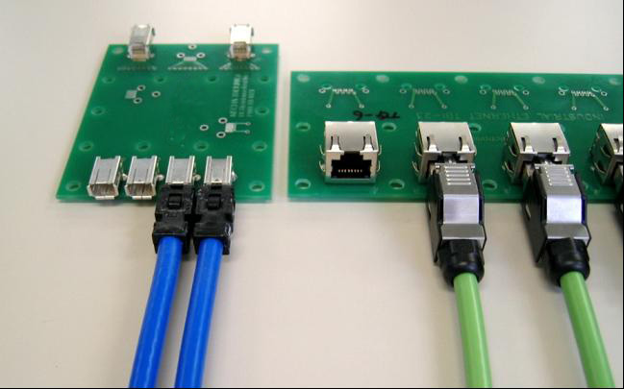
Other Mini-IO Advantages
Industrial Mini-I/O is a reliable compact wire to board connector system for Industrial Communications. It is 25% of the original size of an RJ45.
Blue: Industrial Mini-I/O Connector
Green: RJ45 Connector

Slide 11
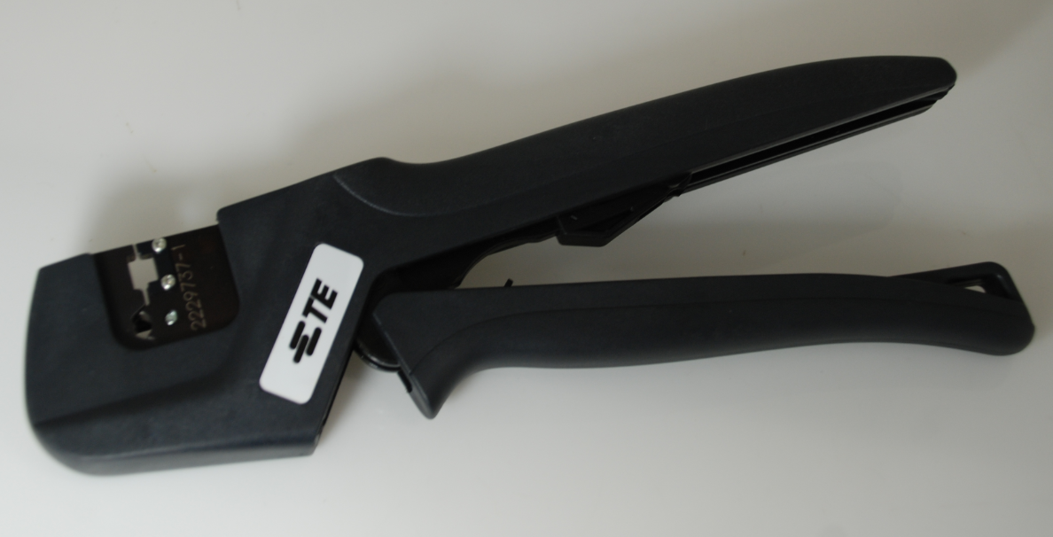
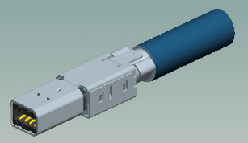
Industrial Mini-I/O Family
Cat6A Field Installable Cable
Connectors
Type 1 and Type II
R/A and vertical Board Connectors
Type 1 and Type II
Solder and piercing cable connectors
Type 1 and Type II
Mini-I/O Cord sets
Type 1 and Type II
  Hand tool is available for wire termination and cable crimp
Wire termination
Cable crimp

Slide 12
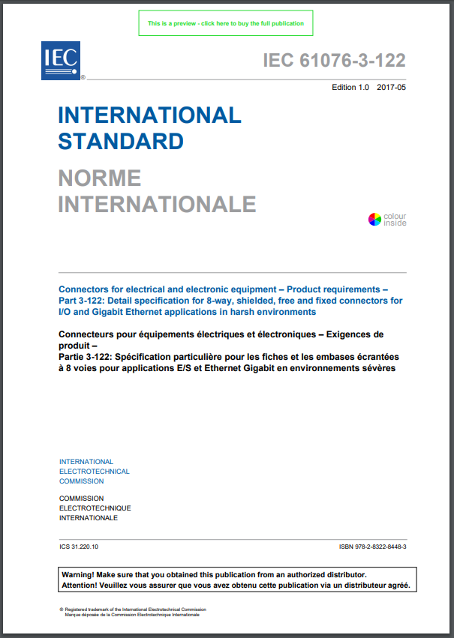
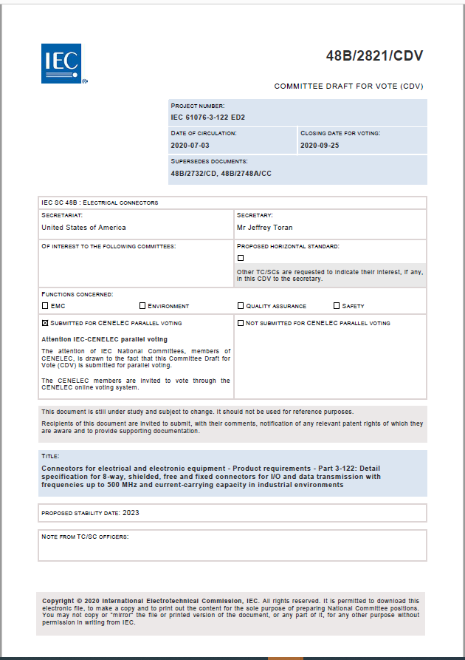
Standardization & Standards

Slide 13
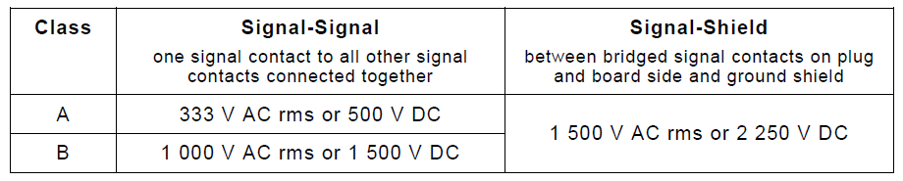
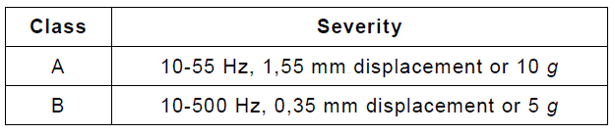
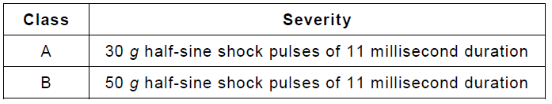
Mini-I/O Standard
The IEC61076-3-122 Mini-I/O standard defines two classes.
Voltage Proof
Class B: New performance requirements for frequencies up to 500 MHz in addition to the performance requirements up to 100 MHz provided with the previous edition ED1
Vibration
Shock

Slide 14
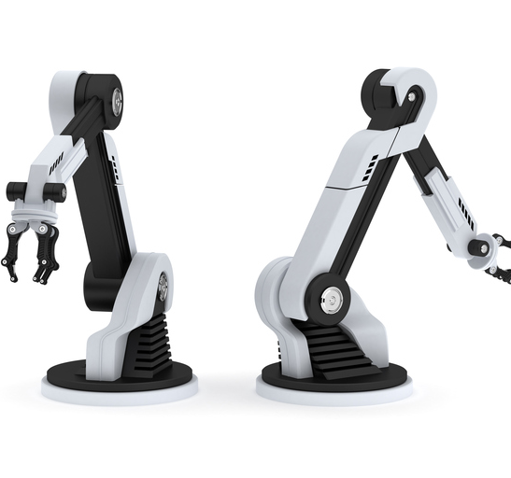

Typical Mini-I/O Applications

Slide 15

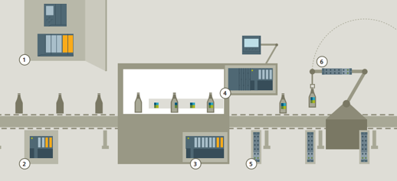
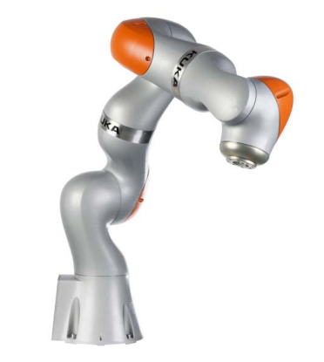
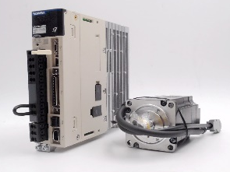
CPS Applications & Connectivity Requirements
 | Cabinet | Distributed Peripherals | Robot & Machine | Drive & Motor
Miniaturized connectors | Small slice widths / high packaging densities | Compact devices | Limited space inside robots and machines | Compact devices
IP code | IP20 | IP20 except near humid processes | IP20 | IP20 except near humid processes
High temperatures | Machine cabinets | Devices attached to robots or machines | Heat-generating processes (e.g. welding) | Rotation
Resilience vs. shock & vibration |  |  | Repetitive movements and sudden changes of direction | Periodical rotation and sudden changes of direction
Resilience vs. EM noise | Alien crosstalk from neighboring cables | Rotating machinery and wireless communication | Rotating machinery
Field- installability | Variable cable lengths |  | N/A (pre-assembled ready-to-install cables) | Variable cable lengths

Slide 16
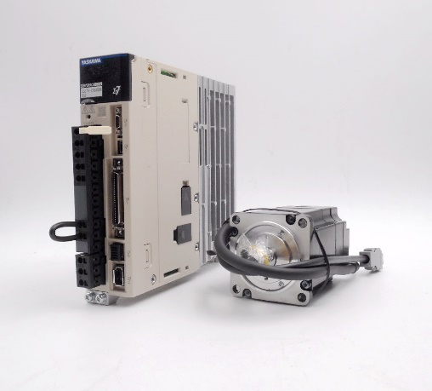
Mini-IO Application Areas & Use Cases
Application Areas
 | General Discrete Manufacturing | Automative Manufacturing | Process Industry | Energy Generation Facilities | Rail
Backbone
M2M
Cabinet
Field
IoT
Mini-IO
application areas
Cabinet
Distributed Peripherals
Robot & Machine
Drive & Motor
Source: Yaskawa
Use Cases
Source: Siemens

Slide 17
Field Installable Cable Connector

Slide 18
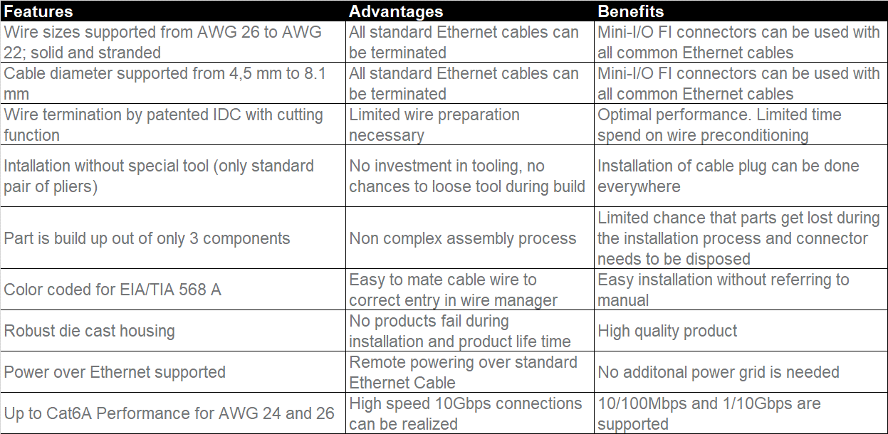
Features, Advantages, Benefits

Slide 19
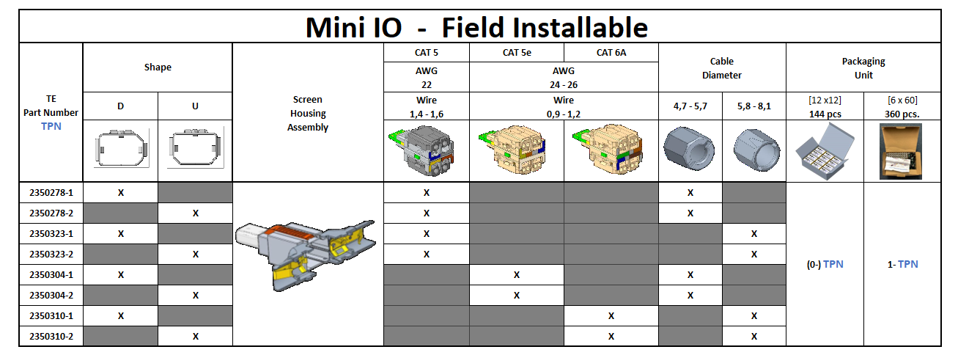
Mini-I/O FI Part Numbers

Slide 20
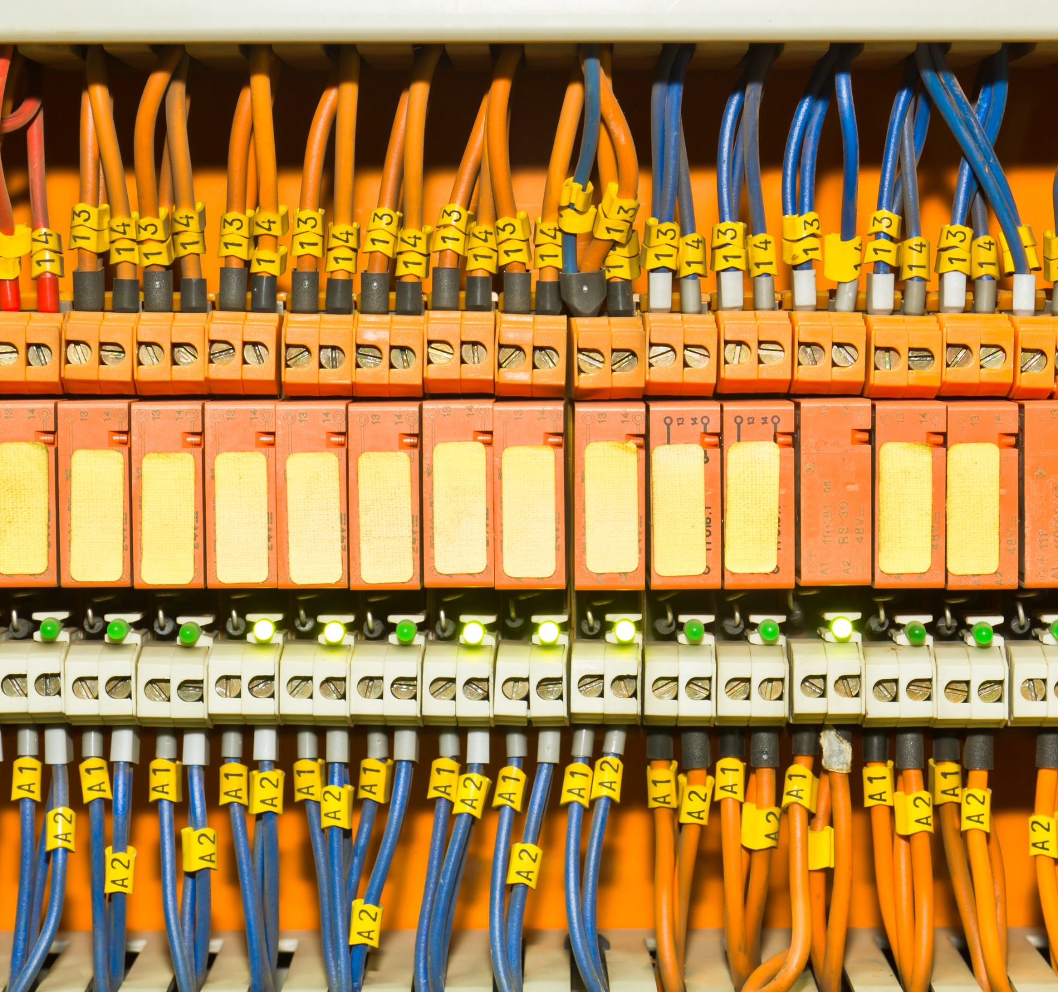
How to Apply the Mini-I/O FI Cable Connector

Slide 21
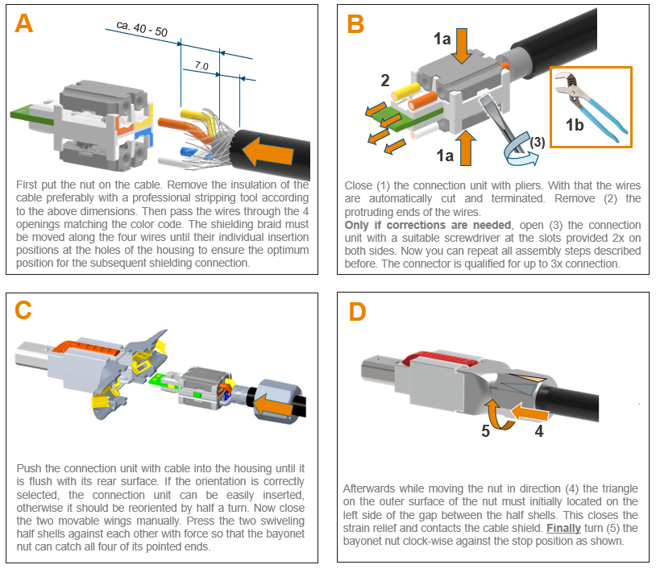
Application of the Mini-I/O Field Installable Connector

Slide 23
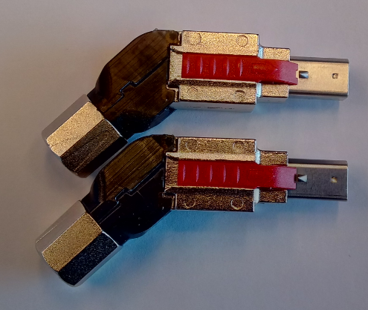
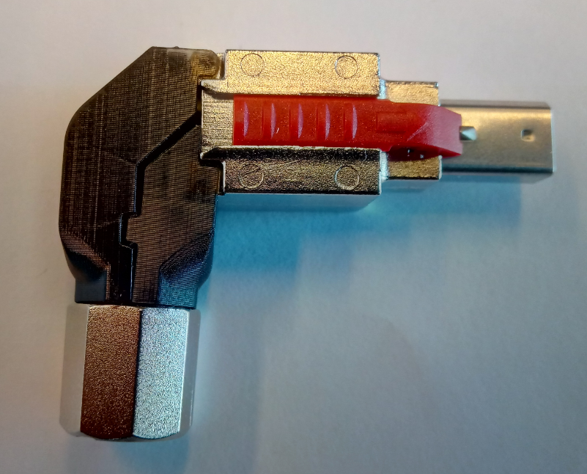
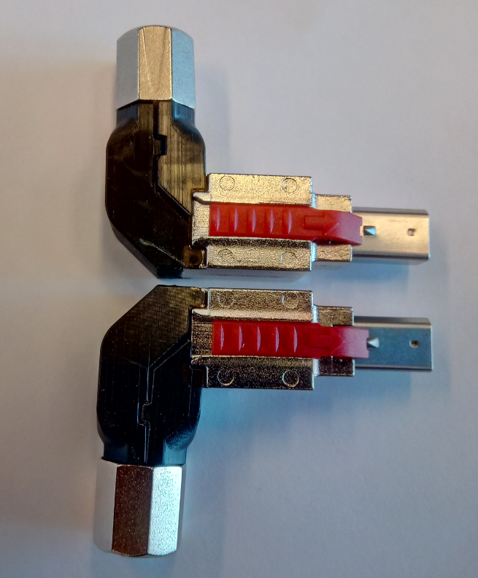
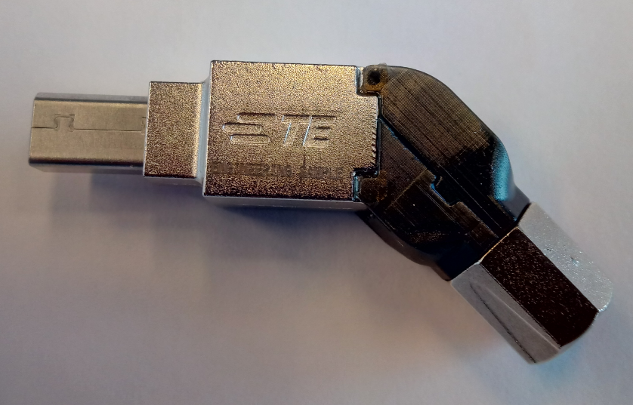
Other Mini-I/O FI variants (as part of the modular concept)
135 degrees Cable Outlet
90 degrees Cable Outlet

Slide 24
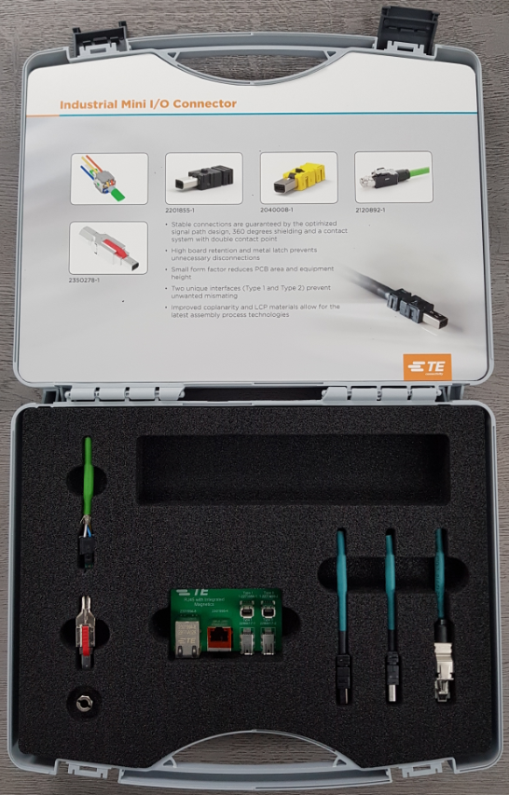
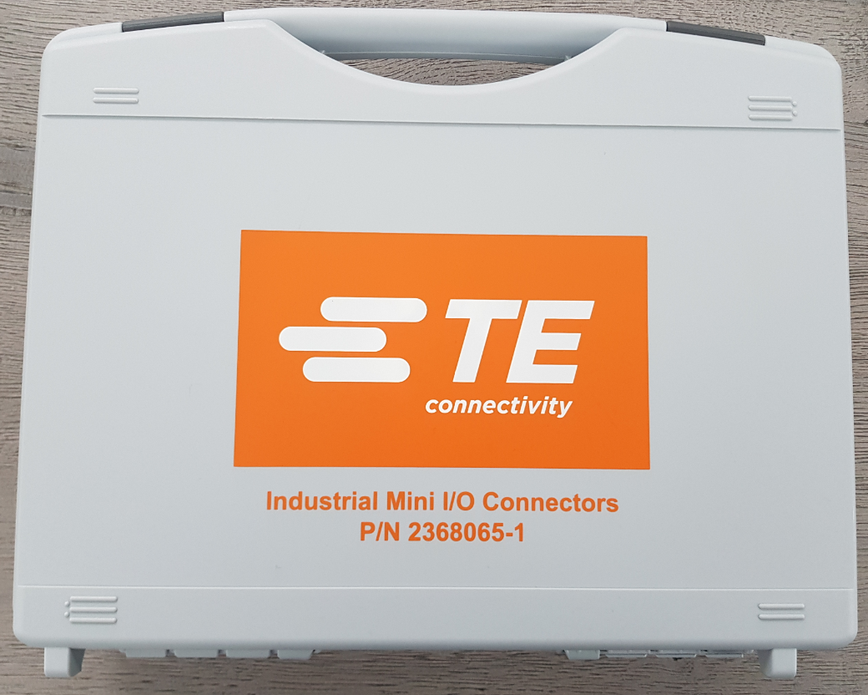
Demo Kit Industrial Mini-I/O:
TE PN 2368065-1

